Slide 1
A guide to kick counting
Presented by:
Lucy Smith, MPH (c)
University of north Texas health science center
Research assistant for Dr. Amy Raines-Milenkov

Slide 2
Purpose
This guide is designed to aid pregnant women and people working with pregnant women in implementing daily kick counting to track changes in fetal movement
Daily tracking of fetal movements has been shown to reduce fetal mortality cases because women can observe and alert their doctor if there is a reduction in fetal movement patterns¹

Slide 3
Background: why is this important in Tarrant county?
“
Kick counting was started due to trends we found at the Case Review Team meeting for Fetal Infant Mortality Review. We reviewed cases where mothers did not understand the importance of kick counts. The mothers would report to their OB or the ER and find out that their babies did not have a fetal heart tone. We found out in the medical records that these mothers would state that they had not felt their babies move in several days to hours. These babies may have been saved if the mothers had understood the importance of counting the baby’s movements and reported this earlier to their OB or going to the ER immediately.
-Rose Mary Bennett, RN, BSN
FIMR Coordinator
Arlington Public Health Center
”

Slide 4
TARRANT COUNTY FETAL INFANT MORTALITY REVIEW (TCFIMR)
TCFIMR program was developed in 2007 and uses the National FIMR model. The Tarrant County Infant Mortality Network was instrumental in garnering the political support to create legislation to establish FIMRS.
The Case Review Team (CRT) has been meeting since June 2008. The CRT includes a mix of professionals and representatives of various agencies that provide services or community resources for families in Tarrant County. Each month the team examines "de-identified" findings from record reviews and interviews with families affected by infant mortality. The infant deaths that are reviewed by the CRT are selected using a systematic random sampling method.
Goal:
Bring community members together to examine social, economic, cultural, safety and health systems factors associated with fetal and infant mortality. Through TCFIMR, the community becomes expert in recommending policy changes and specific interventions to better serve families and the community as a whole.

Slide 5
Evidence for tracking fetal movements
A significant or sudden reduction in fetal activity may be a warning sign of impending fetal death¹
Over ½ of women who have stillbirths report reduced fetal movement in the days before diagnosis²
There is mixed evidence for the success of perceived fetal kick counting by the mother in reducing stillbirth, mostly due to the large variability in study designs and small total number of studies (stillbirth is relatively uncommon in the general population)²
BUT, kick counting is an easy, no-cost method of monitoring fetal movement, and if accurately tracked, can warn the mother of impending fetal problems

Slide 6
What are normal movements?
Most women are aware of fetal movements by 20-24 weeks gestation
Movements include: twists, turns, rolls, jabs, and stretches
Within a week or two of tracking kicks, a woman should be able to see a pattern in fetal movement
Health providers should advise women that fetal movements may plateau around 32 weeks gestation, but that movements should not decrease in frequency
Notes:
Around 32 weeks gestation, the frequency of fetal movements tends to plateau, and the mother may notice a change in the type of fetal movement

Slide 7
What are normal movements?
Average number of movements per hour is 31, and the longest period between movements is 50-75 minutes on average¹
Changes in this number are considered normal and a reflection of fetal growth
Any sudden decrease in movement, as tracked by the mother, should raise alarm and the mother should contact her health care provider immediately
Increased fetal activity is usually seen in the afternoon and evening³
Fetal sleep cycles occur regularly throughout the day, and last around 20-40 minutes⁴

Slide 8
Factors that influence a woman’s ability to perceive fetal movements
Lying down or sitting with feet up increases perception of fetal movement⁵
Fewer movements are perceived when standing or walking⁵
Women who are busy and moving around a lot and not concentrating on fetal activity often misperceive a reduction in fetal movements⁶
Sedating drugs (such as alcohol, benzodiazephines, and opioids) and nicotine can reduce fetal movements^{7,8}

Slide 9
Waking up the baby
Babies take regular naps throughout the day, and on average last 20-40 minutes
To wake up the baby, try:
Walking around for a few minutes
Drinking some water
Eating a meal
If the woman still does not feel her baby move, wait an hour and try again

Slide 10
Kick counting
There is some variability in the recommended amount of movements within a certain time period
We follow American Congress of Obstetricians and Gynecologist’s recommendation that women should feel at least 10 kicks within a 2 hour period
Women should be aware that every pregnant woman is different, and what is a normal amount of fetal activity for one woman may be different for another woman
The point in tracking kick counts is to determine a baby’s normal movement pattern and to recognize when there is a major reduction in activity

Slide 11
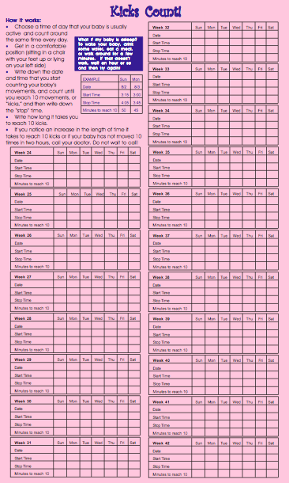
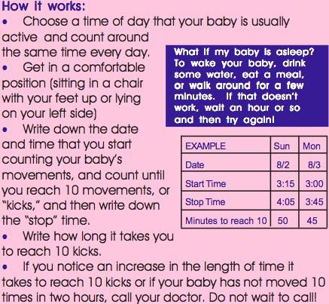
IMN kick counting campaign
The full brochure (Spanish and English versions) can be downloaded from:
http://www.infantmortalitynetwork.org/

Slide 12
Kick Counting instructions on brochure
1. Choose a time of day that the baby is most active (usually in the afternoon or evening) and count around the same time everyday
2. Get in a comfortable position when counting, such as lying on your left side or sitting in a chair with your feet propped up
3. Write down the date and time that you start counting your baby’s movements, and count until you reach 10 “kicks”, and then write down the “stop” time

Slide 13
Kick Counting instructions on brochure
4. Write down how long it takes you to reach 10 kicks
5. If you notice an increase in the length of time it takes to reach 10 kicks or you baby does not kick 10 times in 2 hours, call your doctor. Do not wait to call!

Slide 14
Other benefits of kick counting
In addition to being an easy and effective method of monitoring a baby’s health and reducing the chances of stillbirth, kick counting also helps to:
Improve the bond between mother and baby
Improve recognition of movement patterns and personality of baby
Improve alertness of movement abnormalities so a health care provider can be alerted in a timely manner

Slide 15
Other benefits
Encouraging a woman to involve her partner in tracking kick counts can be a great way to increase paternal bonding with the baby

Slide 16
Possible barriers
Getting a woman to be still and relax for 1-2 hours a day to track movements may be hard if she is working or on her feet most of the day
Some women may feel that monitoring fetal movement is useless or a nuisance, and it may even increase anxiety in some women⁹
This small minority of women should be reminded that stillbirth is relatively uncommon in normal pregnancies, and if daily kick count tracking raises anxiety to unnecessary levels, then it should not be used

Slide 17
Special population: Teens
Teens represent a special population in kick counting because of their inexperience in mother- and adult-hood
There is an increased association between stillbirth and young maternal age¹⁰
Teens are also less likely to comply with regular prenatal care¹¹

Slide 18
Special population: Teens
Possible barriers in teen kick counting
Doubting that the method is useful and/or not understanding the importance of it
Feeling embarrassed to track and record fetal movements or in asking how to do it
Not wanting to make a big deal about any sudden changes in fetal movements for fear of seeming “high-maintenance” or a “worrier” to their family and doctor
Having low self-efficacy in the belief that they can successfully track daily fetal movements

Slide 19
Special population: Teens
Teens should be given easily-understandable information on how to perform kick counts, and should be reminded of its use
Use of the kick counting method should be emphasized as an easy-to-do routine to track the baby’s health, but it should never replace the care received by the teen’s doctor at prenatal visits
Using incentives to promote daily kick count tracking may be a possible way to increase usage and adoption throughout pregnancy

Slide 20
For more information
For more information, and to download free copies of the Kicks Count! brochure (Spanish and English versions available), visit the Tarrant County Infant Mortality Network website
http://www.infantmortalitynetwork.org/

Slide 21
Tarrant county infant mortality network
The Network is a community-based collaborative resource that works to improve pregnancy outcomes and community-based clinical and social services that support newborn babies and their families.
The Tarrant County Infant Mortality Network serves as a change catalyst to reduce infant mortality in Tarrant County through:
Strong community-based collaborations and mobilization of resources among medical, social service, and faith community leaders,
The generation and use of cutting-edge, evidence-based maternal and child health data to direct improvements to community-based clinical and social service programs that help families have healthy, thriving babies, and
Leading data-driven advocacy at the local, State, and Federal levels to increase access to prenatal care and support for the most affected indigent communities.

Slide 22
References
Whitworth, M., Fisher, M., & Heazell, A. (2011). Green-top guidelines: Reduced fetal movements. Royal college of obstetricians and gynaecologists, 1(57)
Matthias, G. S. H., & Morgan, G. (1993). Fetal movements, maternal serum α-fetoprotein and the mode of death in unexplained stillbirth. Journal of Obstetrics and Gynaecology, 13(4), 233-234. Retrieved from www.scopus.com
Patrick, J., Fetherston, W., Vick, H., Voegelin, R. (1978). Human fetal breathing movements and gross fetal body movements at weeks 32 to 35 of gestation. Am J Obstet Gynecol, 130(693-699).
Patrick, J., Campbell, K., & Carmichael, L. (1982). Patterns of gross fetal body movements over 24-hour observation intervals during the last 10 weeks of pregnancy. American Journal of Obstetrics and Gynecology, 142(4), 363-371. Retrieved from www.scopus.com
Minors, D. S., & Waterhouse, J. M. (1979). The effect of maternal posture, meals and time of day on fetal movements. British Journal of Obstetrics and Gynaecology, 86(9), 717-723. Retrieved from www.scopus.com
Cito, G., Luisi, S., Mezzesimi, A., Cavicchioli, C., Calonaci, G., & Petraglia, F. (2005). Maternal position during non-stress test and fetal heart rate patterns. Acta Obstetricia Et Gynecologica Scandinavica, 84(4), 335-338. Retrieved from www.scopus.com
Richardson, B. S., O'Grady, J. P., & Olsen, G. D. (1984). Fetal breathing movements and the response to carbon dioxide in patients on methadone maintenance. American Journal of Obstetrics and Gynecology, 150(4), 400-405. Retrieved from www.scopus.com
Castillo, R. A., Devoe, L. D., Ruedrich, D. A., & Gardner, P. (1989). The effects of acute alcohol intoxication on biophysical activities: A case report. American Journal of Obstetrics and Gynecology, 160(3), 692-693. Retrieved from www.scopus.com
Draper, J., Field, S., Thomas, H., & Hare, M. J. (1986). Womens' views on keeping fetal movement charts. British Journal of Obstetrics and Gynaecology, 93(4), 334-338. Retrieved from www.scopus.com
Salihu, H. M., Sharma, P. P., Ekundayo, O. J., Kristensen, S., Badewa, A. P., Kirby, R. S., & Alexander, G. R. (2006). Childhood pregnancy (10-14 years old) and risk of stillbirth in singletons and twins. Journal of Pediatrics, 148(4), 522-526. Retrieved from www.scopus.com
Felice, M. E., Feinstein, R. A., Fisher, M. M., Kaplan, D. W., Olmedo, L. F., Rome, E. S., & Staggers, B. C. (1999). Adolescent pregnancy - current trends and issues: 1998. Pediatrics, 103(2), 516-520. Retrieved from www.scopus.com

